Slide 1
Meta Compiler
( Compiler Compiler Compiler)
M. Lakshmi Narasimha - ES21BTECH11018
B. Sahishnu - CS21BTECH11009
G. Gaman - ES21BTECH11014
K. Charusheel - ES21BTECH11017

Slide 2
Project objective:
To create a compiler for the ccc language which is DSL for lexical and syntax analysis.

Slide 3
Lexer Overview
This is the initial phase of the ccc compiler.
The lexer takes .ccc file as an input and produces the sequence of valid tokens for the parser.
This also handles removal of comments and whitespaces.
On reaching an invalid token, lexer stops and outputs the corresponding error.
Along with the tokens sequence, each token and it’s type is printed in separate output file.
The corresponding clike code is printed into another output file.

Slide 4
Understanding the implementation

Slide 5
Identifiers and constants are similar to C language.
Reserved keywords include most of the statements that are allowed in c such as “for”, “while”, “if”, “return”, data types, etc, since ccc language allows some c statements along with ccc functionalities.
Additional keywords such as “pass”, “regex”, “grammar”, etc, are introduced for the basic functionalities of ccc DSL.
Lexer identifies the tokens from ccc file and returns that token to the parser, or gives an appropriate error in case of invalid token.
Also for the new DSL functionalities of example.ccc, the lexer generates equivalent clike code which is C-syntactically incorrect, but gives some insights into example.ccc.

Slide 6
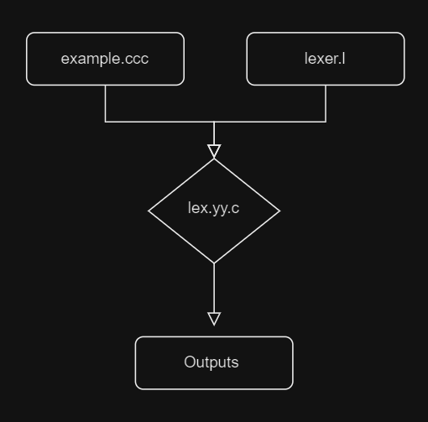
Execution
Rename the input filename in bash script “lrun” as “example.ccc”.
Run the bash script “lrun” on terminal.
It generates lex.yy.c file corresponding to our lexer.l file.
Then it runs the lex.yy.c on the given input file to give sequence of tokens to the parser and required output files.
Note: The lexer runs on flex, so the flex tool is pre-requisite on the executing platform.

Slide 7
Input File
Takes the input from example.ccc file to generate corresponding tokens and output files.
Note:
Input file path should be modified or mentioned according to the Readme file.

Slide 8
Output Files
Two files will be generated example.tokens and example.clike.
Note:
Here .clike file doesn’t correspond to C syntax, it is just small modifications of the input .ccc file to make it more readable in C format.

Slide 9
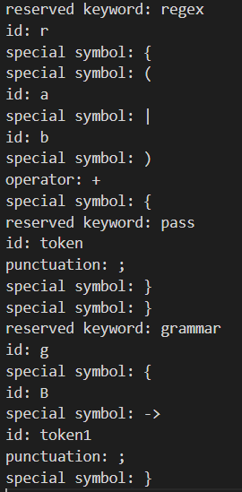
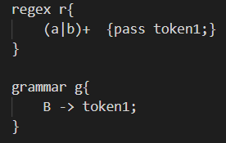
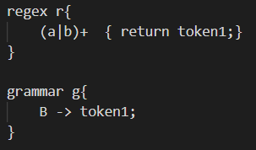
Test Case Example
example.tokens
example.ccc
exexample.clikeamplelike

Slide 10
Parser Overview
This is the second phase of the ccc compiler.
The parser takes sequence of tokens as input and verifies the sequence against the grammar rules.
Grammar parses the input tokens using LALR(1) parsing.
On reaching an invalid state or the sequence does not match against any production, the parser returns syntax error.
With each statement production rule, the statement along with its type is printed in the output file.
The tokens that can be received are predefined before a production rules in the parser.

Slide 11
Understanding the implementation

Slide 12
Declaration, condition, loop, expression, return and call statements are similar to C language.
New grammar rules are introduced to verify the syntax of “regex” and “grammar” code snippets in “example.ccc”
This does not verify the productions in “grammar” body instead it checks the syntax of those productions against its own production rules (meta).
Some minor scopes checks for “regex” and “grammar” are implemented, so it will be simpler in case of future semantic analysis.
Operators such as “+”, “ * ” are mentioned in several productions since they have different meaning inside “regex”.

Slide 13
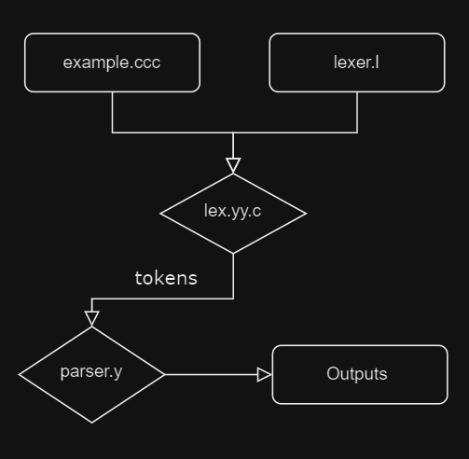
Execution
Rename the input filename in bash script “grun” as “example.ccc”.
Run the bash script “grun” on terminal.
It generates tokens as input to “parser.y” after executing “lex.yy.c” on input.
Then it runs the parser.y on the sequence of tokens to verify and classify the type of statements that tokens correspond to.
Note: The parser runs on bison, so the bison tool is pre-requisite on the executing platform.

Slide 14
Input File
Takes the sequence of tokens input from “lex.yy.c” file to verify the input’s syntax and categorize it to the corresponding statement.
Note:
Input file path should be modified or mentioned according to the Readme file.

Slide 15
Output Files
An output file named example.parsed will be generated.
Note:
This will contain the type of statement that each statement belong to, along with the statement itself.

Slide 16
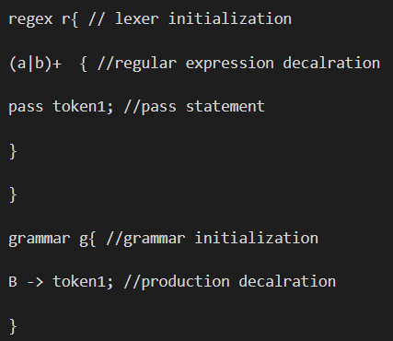
Test Case Example
example.parsed
example.ccc

Slide 17
THANK YOU

Slide 18
Team 17
TEAM 17
Sahishnu
Charusheel
Narasimha
Gaman
Language Guru and Tester
System Architect and Tester
System Integrator and Tester
Project Manager and Tester

